Slide 1
Requirement Analysis Part 1
Software Quality Engineering
CT051-3-3
Software Engineering

Slide 2
Topic & Structure of the lesson
Functional and non-functional requirements
User requirements
System requirements
Interface specification
The software requirements document

Slide 3
Learning Outcomes
By the end of this lecture, YOU should be able to:
  Introduce the concepts of user and system requirements
  Describe functional and non-functional requirements
  Explain how software requirements may be organised in a requirements document

Slide 4
What is a requirement?
A set of conditions or capabilities needed by a stakeholder to solve a problem or achieve an objective that must be met or possessed by a system or system component.
According to Davis (1993) requirement abstraction is defining requirements in a way that allows for multiple, potentially different, solutions.
  May be the basis for a bid for a contract – therefore, must be open to interpretation
  May be the basis for the contract itself – therefore, must be defined in detail

Slide 5
What is Requirement Engineering?
A systematic and disciplined approach to the elicitation, gathering, and verifying of requirements to guarantee the effective developing of high-quality software.

Slide 6
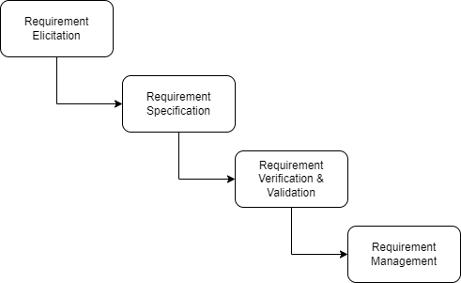
Requirement Engineering Process
The goal of this step is to understand the problem that the software system is intended to solve and the needs and expectations of the stakeholders who will use the system.
Our Concern
The process of documenting the requirements identified in the analysis step in a clear, consistent, and unambiguous manner. This step also involves prioritizing and grouping the requirements into manageable chunks.
Verification: It refers to the set of tasks that ensures that the software correctly implements a specific function.
Validation: It refers to a different set of tasks that ensures that the software that has been built is traceable to customer requirements.
The process of managing the requirements throughout the software development life cycle, including tracking and controlling changes, and ensuring that the requirements are still valid and relevant.

Slide 7
Importance of Requirement Analysis
Clear Understanding of Stakeholder Needs: Effective requirement analysis, developers will gain in-depth understanding of the of all stakeholders needs.
Avoiding Scope Creep: Properly documenting the requirements at the beginning, it ensure that they are made within the project’s boundaries.
Improved Communication: This will ensure that all parties are on the same understanding and can avoid potential misunderstandings among stakeholders.
Reduced Rework Costs: When requirements are clear and well-documented will avoid frequent revisions. This helps reduce the time spent on rework and minimize overall development costs.
Minimized uncertainties: Clear, complete and consistent requirements helps to minimize uncertainty and build correct and intended features and deliver quality product.
Quality Planning (Project): Proper and detail requirement analysis will provide accurate information to manage the timelines, and it will improve project management.
Product Satisfaction: Clear, complete and consistent requirements will ensure higher product quality and greater user satisfaction.

Slide 8
Type of Requirements
Functional requirements
  These describe what the system should do — the specific behaviors, functions, and features.
    Examples:
      User login and authentication,
      Data input and validation,
      Generating reports,
      Sending notifications, Processing transactions
    Characteristics:
      Directly related to user interactions,
      Can be mapped to specific use cases
      Often documented in Software Requirements Specifications (SRS)

Slide 9
Type of Requirements
Non-functional requirements
  These describe how the system performs — the quality attributes and constraints.
    Examples:
      Performance (e.g., response time < 2 seconds)
      Scalability
      Security (e.g., data encryption)
      Usability
      Maintainability
      Compliance with standards
    Characteristics:
      Not tied to specific functionalities
      Affect the overall system architecture
      Often influence design decisions and testing strategies

Slide 10
Type of Requirements
Domain requirements
  These are constraints or rules specific to the application domain — they reflect the business logic, industry standards, or regulatory requirements.
  Examples:
    A healthcare system must follow HIPAA guidelines
    A university grading system must support GPA calculation based on institutional rules
  Characteristics:
    Derived from domain knowledge or stakeholder input
    May influence both functional and non-functional requirements
    Often harder to change due to regulatory or business constraints

Slide 11
Requirements imprecision
Problems arise when requirements are not precisely stated.
Ambiguous requirements may be interpreted in different ways by developers and users.
Consider the term ‘appropriate viewers’
  User intention - special purpose viewer for each different document type;
  Developer interpretation - Provide a text viewer that shows the contents of the document.

Slide 12
Requirements completeness and consistency
In principle, requirements should be both complete and consistent.
Complete
  They should include descriptions of all facilities required.
Consistent
  There should be no conflicts or contradictions in the descriptions of the system facilities.
In practice, it is impossible to produce a complete and consistent requirements document.

Slide 13
Non-functional requirements
These define system properties and constraints e.g. reliability, response time and storage requirements. Constraints are I/O device capability, system representations, etc.
Process requirements may also be specified mandating a particular CASE system, programming language or development method.
Non-functional requirements may be more critical than functional requirements. If these are not met, the system is useless.

Slide 14
Non-functional classifications
Product requirements
  Requirements which specify that the delivered product must behave in a particular way e.g. execution speed, reliability, etc.
Organisational requirements
  Requirements which are a consequence of organisational policies and procedures e.g. process standards used, implementation requirements, etc.
External requirements
  Requirements which arise from factors which are external to the system and its development process e.g. interoperability requirements, legislative requirements, etc.

Slide 15
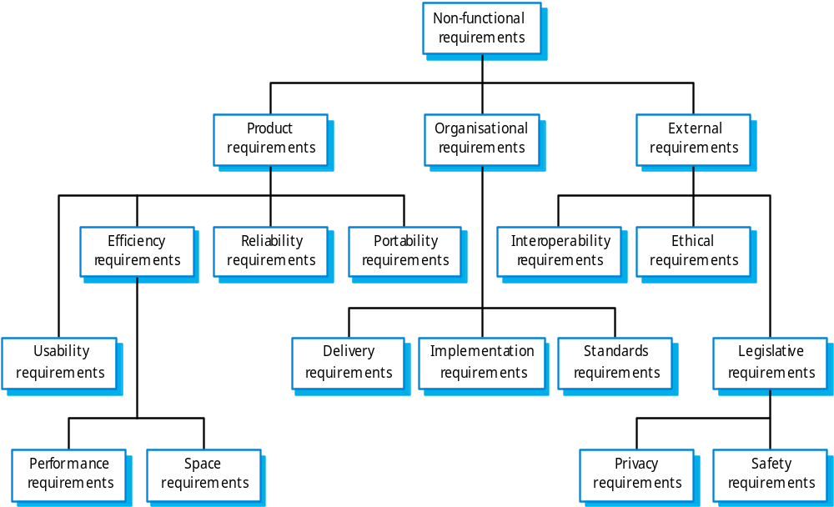
Non-functional requirement types

Slide 16
Examples
A system goal
  The system should be easy to use by experienced controllers and should be organised in such a way that user errors are minimised.
A verifiable non-functional requirement
  Experienced controllers shall be able to use all the system functions after a total of two hours training. After this training, the average number of errors made by experienced users shall not exceed two per day.

Slide 17
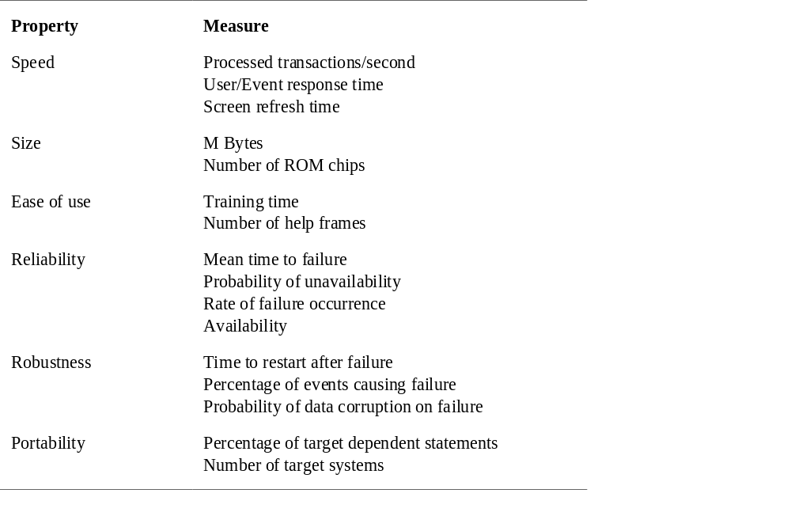
Requirements measures

Slide 18
Requirements interaction
Conflicts between different non-functional requirements are common in complex systems.
Spacecraft system
  To minimise weight, the number of separate chips in the system should be minimised.
  To minimise power consumption, lower power chips should be used.
  However, using low power chips may mean that more chips have to be used. Which is the most critical requirement?

Slide 19
Domain requirements
Derived from the application domain and describe system characteristics and features that reflect the domain.
Domain requirements be new functional requirements, constraints on existing requirements or define specific computations.
If domain requirements are not satisfied, the system may be unworkable.

Slide 20
Library system domain requirements
There shall be a standard user interface to all databases which shall be based on the Z39.50 standard.
Because of copyright restrictions, some documents must be deleted immediately on arrival. Depending on the user’s requirements, these documents will either be printed locally on the system server for manually forwarding to the user or routed to a network printer.

Slide 21
Domain requirements problems
Understandability
  Requirements are expressed in the language of the application domain;
  This is often not understood by software engineers developing the system.
Implicitness
  Domain specialists understand the area so well that they do not think of making the domain requirements explicit.

